Slide 1



SORT WITHOUT EXTRA SPACE
"Sort without extra space" refers to the process of rearranging elements in an array or data structure to achieve a sorted order without using additional memory or storage space to store the sorted values separately. In other words, the sorting algorithm modifies the original array in-place to obtain the sorted result, without allocating memory for a new sorted array.
Consider the queue made up of two parts, one is sorted and the other is not sorted. Initially, all the elements are present in not sorted part.
At every step, find the index of the minimum element from the unsorted queue and move it to the end of the queue, that is, to the sorted part.
Repeat this step till all the elements are not present in the sorted queue.
Time Complexity: O(n^2) - Quadratic time complexity due to nested loops.
Space Complexity: O(1) - Constant space complexity, as no additional data structures are used proportional to the input size.

Slide 2
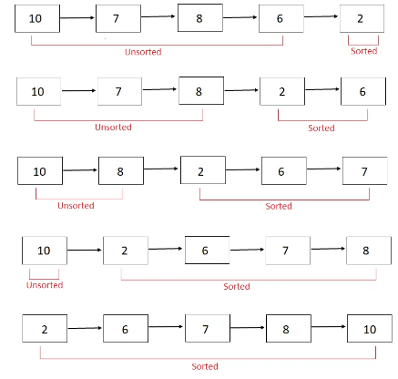

SORT WITHOUT EXTRA SPACE
ILLUSTRATION
At every step, find the index of minimum element in the unsorted part and move it to the end of the queue, that is, sorted part.

Slide 3
import java.util.*;
public class MergeSort {
public static void main(String[] args) {
Scanner sc=new Scanner (System.in);
int n=sc.nextInt();
int[] array = new int[n];
for (int i=0;i<array.length;i++){
array[i]=sc.nextInt();
}
Arrays.sort(array);
for (int i:array){
System.out.print(i+" ");
}
}
}

Slide 4
INTERVIEW QUESTIONS
3. Are there any trade-offs when using in-place sorting algorithms for the "Sort Without Extra Space" problem?
Answer: Yes, there are trade-offs. While in-place sorting algorithms conserve memory, they may have slightly higher time complexity compared to algorithms that use extra space. However, this trade-off is often acceptable when memory is a critical concern.

